Slide 1
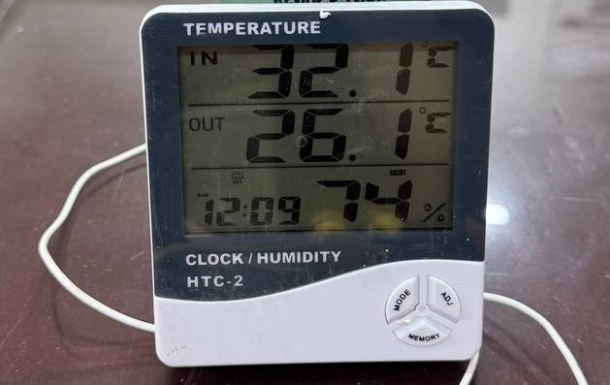

BANGLADESH UNIVERSITY OF ENGINEERING AND TECHNOLOGY
Department of Civil Engineering
Heat of Hydration of
Portland and Composite Cements
Under Semi-Adiabatic Conditions
Zisan Zia
Abdur Nur Tushar
ID: 2004153
ID: 2004061
Supervisor: Dr. Raquib Ahsan, Professor, Dept. of Civil Engineering, BUET
1

Slide 2
Portland vs. Composite Cement
2004153
P
C
Portland Cement — CEM I
Composite Cement — CEM II
High clinker content
Fast early hydration
Higher heat release
Useful for early strength gain
Clinker partly replaced by SCM/filler
Slower heat evolution
Lower thermal cracking risk
Suitable for large mass pours
Clinker: High
Heat: High
Clinker: Lower
Heat: Lower
Replacing clinker generally reduces heat — but rapid-hardening composite cement can still spike early heat through increased fineness.
Zisan Zia • 2004153
2
Dept. of Civil Engineering, BUET

Slide 3
Reasons Behind Choosing Semi-Adiabatic Calorimetry
2004153
≈
△
Isothermal Calorimetry
Semi-Adiabatic Calorimetry
T = constant (bath)
T rises naturally (insulated vessel)
Keeps temperature constant
Very accurate for reaction kinetics
Requires specialized instrument
Small sample — not representative of field
vs
Allows limited, controlled heat loss
Temperature rises as in real concrete
Practical, low-cost, reproducible
Closest to field mass concrete behaviour
Real concrete is neither isothermal nor perfectly adiabatic — semi-adiabatic captures the practical heat-retention condition of mass placements.
3
Zisan Zia • 2004153
Dept. of Civil Engineering, BUET

Slide 4
Reasons Behind Hydration Heat Calculation
2004153
1
2
Reaction Speed
Total Heat
q(t) shows how fast the cement reacts at each instant
Q(t) shows heat stored over time — drives temperature rise
3
4
Cracking Risk
Cement Choice
High heat → high ΔT → thermal stress exceeding tensile strength
Low-heat cement identified as suitable for mass concrete pours
Hydration heat parameters feed early-age thermal analysis, temperature-control planning, and cement selection for mass concrete.
4
Zisan Zia • 2004153
Dept. of Civil Engineering, BUET

Slide 5
Research Gaps
2004153
BD
Bangladesh Cement Data Gap
Limited semi-adiabatic hydration heat data for BDS EN 197-1 cement types commonly used in Bangladeshi construction.
⚡
Early Heat Risk Gap
Rapid-hardening composite cement (CEM II A-M 42.5 R) produces faster early heat — this behaviour is rarely isolated from normal composite cement.
✓
Composite Cement Validation Gap
CEM II A-M and B-M with mixed secondary constituents lack systematic heat-evolution validation under semi-adiabatic conditions.
This study fills all three gaps: XRD + semi-adiabatic calorimetry + MATLAB modelling + VCCTL simulation
5
Zisan Zia • 2004153
Dept. of Civil Engineering, BUET

Slide 6
Objectives and Scope
2004153
Objective 1 — Characterise & Measure
Objective 2 — Heat Modeling & Validation
Convert temperature rise into hydration heat release
Analyze heat emission rate and cumulative heat evolution
Model hydration peaks using MATLAB Gaussian fitting
Generate smooth polynomial heat functions for thermal simulation
XRD phase identification (C₃S, C₂S, C₃A, CaCO₃, SCM)
Temperature development under sealed conditions
Heat generation rate q(t) and cumulative heat Q(t)
Key Output Parameters
q(t)
Q(t)
Peak time
α(t)
Risk rank
Heat generation rate
Cumulative heat release
Time to max heat rate
Degree of hydration
Cement suitability
6
Zisan Zia • 2004153
Dept. of Civil Engineering, BUET

Slide 7
Four Cement Samples Compared
2004153
CEM I
52.5 N
CEM II A-M
42.5 R
CEM II A-M
42.5 N
CEM II B-M
42.5 N
Portland
Composite, rapid
Composite, normal
Higher composite
high clinker / high-heat reference
rapid-hardening spike early heat
intermediate heat control
low-heat candidate for mass concrete
Heat Baseline
Early-Heat Challenge
Comparison Point
Low-Heat Target
7
Zisan Zia • 2004153
Dept. of Civil Engineering, BUET

Slide 8
Research Workflow
2004153
1
2
3
Cement Selection
Sample Prep
XRD Testing
Sealed paste
w/c ≈ 0.40
Identify C₃S, C₂S,
C₃A, CaCO₃, SCM
CEM I 52.5 N
CEM II A-M 42.5 R
CEM II A-M 42.5 N
CEM II B-M 42.5 N
4
5
6
Calorimetry
Heat Calculation
Model & Validate
Record Tₛ(t)
and Tₐₘᵦ(t)
q(t), Q(t)
and peak time
Gaussian, polynomial,
VCCTL( Virtual Cement and Concrete Testing Laboratory)
8
Zisan Zia • 2004153
Dept. of Civil Engineering, BUET

Slide 9
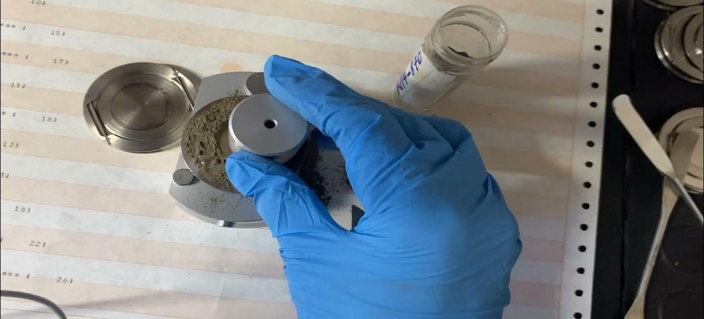
Sample Preparation and XRD Testing
2004153
01
Oven Dry
Remove moisture before XRD to avoid peak distortion
02
Grind Powder
Achieve fine, uniform particles for flat sample surface
03
Load Holder
Flat surface, minimise preferred orientation effects
04
Run XRD Scan
6°–90° 2θ with Cu Kα₁, step 0.026°, 7.14 s/step
powder sample
05
Match Phases
HighScore Plus software + ICDD PDF database
9
Zisan Zia • 2004153
Dept. of Civil Engineering, BUET

Slide 10
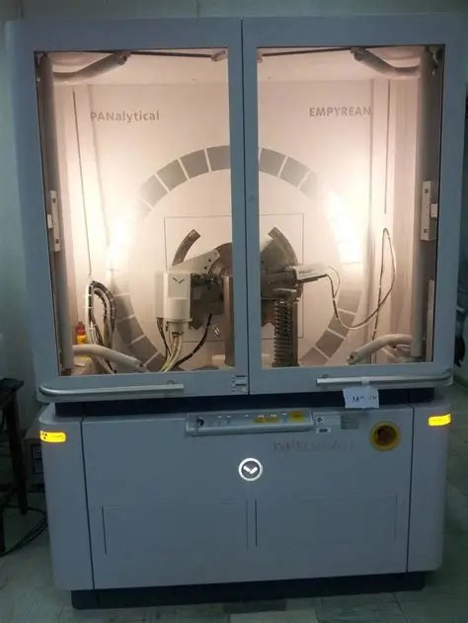
XRD Measurement Conditions
2004153
Parameter | Value
Instrument | PANalytical EMPYREAN
Radiation | Cu Kα₁ = 1.54060 Å
Scan range | 6.006° – 89.986° 2θ
Step size | 0.0260° 2θ
Step time | 7.1400 s
Generator | 45 kV, 40 mA
Temperature | 25 °C
10
Zisan Zia • 2004153
Dept. of Civil Engineering, BUET

Slide 11
XRD diffractograms: four samples
2004153
CEM II B-M 42.5 N
CEM II A-M 42.5 N
CEM II A-M 42.5 R
CEM I 52.5 N
11
Zisan Zia • 2004153
Dept. of Civil Engineering, BUET

Slide 12
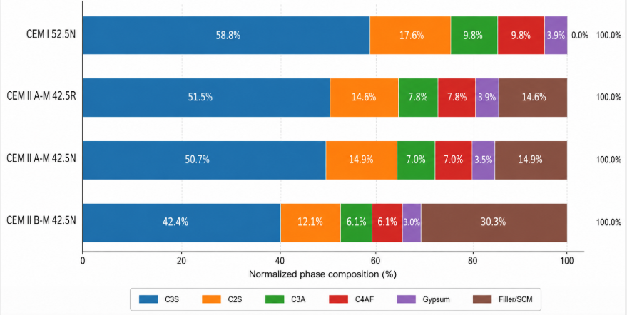
Semi-Quantitative XRD Phase Composition
2004153
Why rapid hardening shows high early heat
CEM II A-M 42.5R has a high reactive clinker fraction:
C₃S + C₂S + C₃A + C₄AF
= 51.5 + 14.6 + 7.8 + 7.8
= 81.7%
High C₃S gives faster early hydration and strength gain
C₃A increases early heat emission
12
Zisan Zia • 2004153
Dept. of Civil Engineering, BUET

Slide 13
From Phase Composition to Heat Evolution
2004153
C₃S / Alite
Fast heat + early strength
C₂S / Belite
Slower, later-age hydration
C₃A / Aluminate
Early exothermic spike (1st peak)
CaCO₃ / Filler
Clinker dilution → reduces heat generation
Mixed Mineral Additions
Slower hydration + lowest cumulative heat
13
Zisan Zia • 2004153
Zisan Zia • 2004153
Dept. of Civil Engineering, BUET
Dept. of Civil Engineering, BUET

Slide 14
CEM II A-M 42.5R
2004153
High Reactive Clinker Fraction
Best For — Early Strength Applications
C₃S
51.5%
✓ Precast concrete — fast demoulding cycle
C₂S
14.6%
✓ Cold-weather pours — gain strength before freeze
C₃A
7.8%
✓ Rapid formwork removal in framed structures
C₄AF
7.8%
✓ Road repairs needing early opening to traffic
Filler
14.5%
14
Zisan Zia • 2004153
Dept. of Civil Engineering, BUET

Slide 15
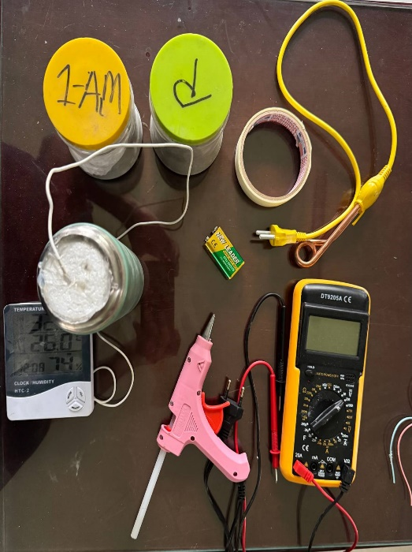
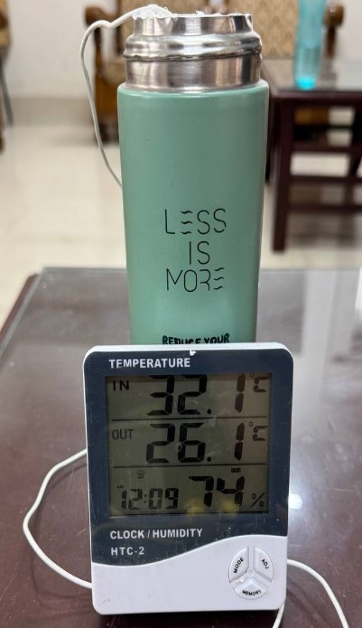
Semi-Adiabatic Calorimetry Setup
2004153
2004153
Semi-Adiabatic Calorimetry Setup
14 / 22
Instrumental Setup
instrumented setup
temperature logging
15
Zisan Zia • 2004153
Dept. of Civil Engineering, BUET

Slide 16
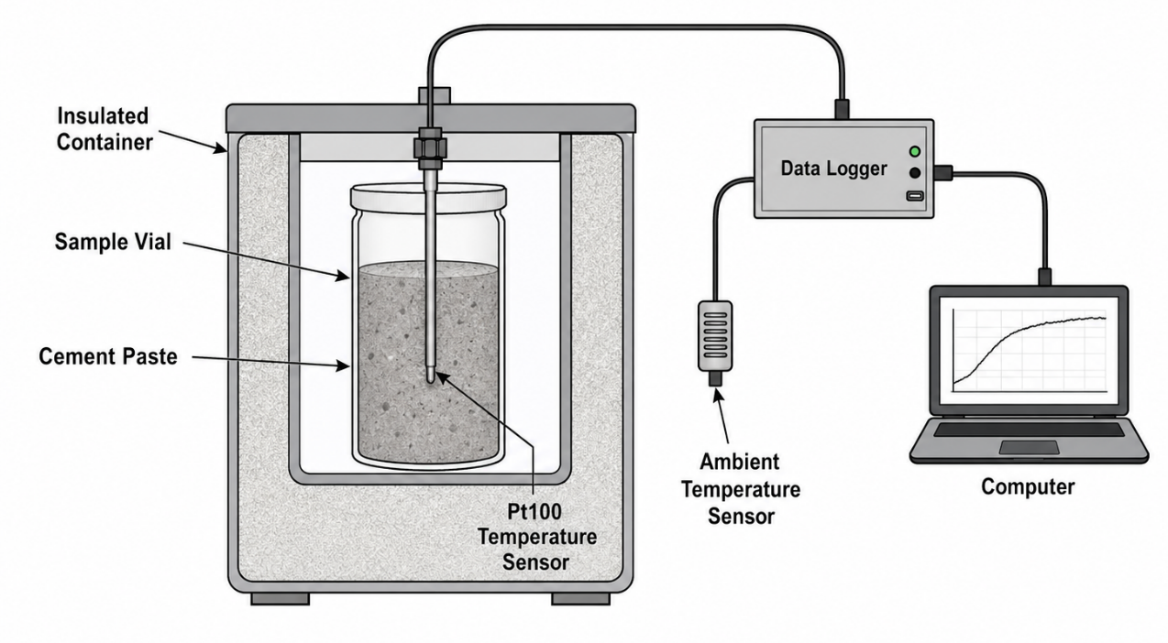
Semi-Adiabatic Calorimetry Setup
2004153
1
Sample Vial
Sealed cement paste (w/c=0.40) in polypropylene vial
2
Temperature Sensors
Thermocouples record Tₛ(t) sample and Tₐₘᵦ(t) ambient
3
Insulation
Limits — but does not eliminate — heat loss to surroundings
4
Data Logger + PC
setup schematic
Continuous temperature record at fixed time intervals
16
Zisan Zia • 2004153
Dept. of Civil Engineering, BUET

Slide 17
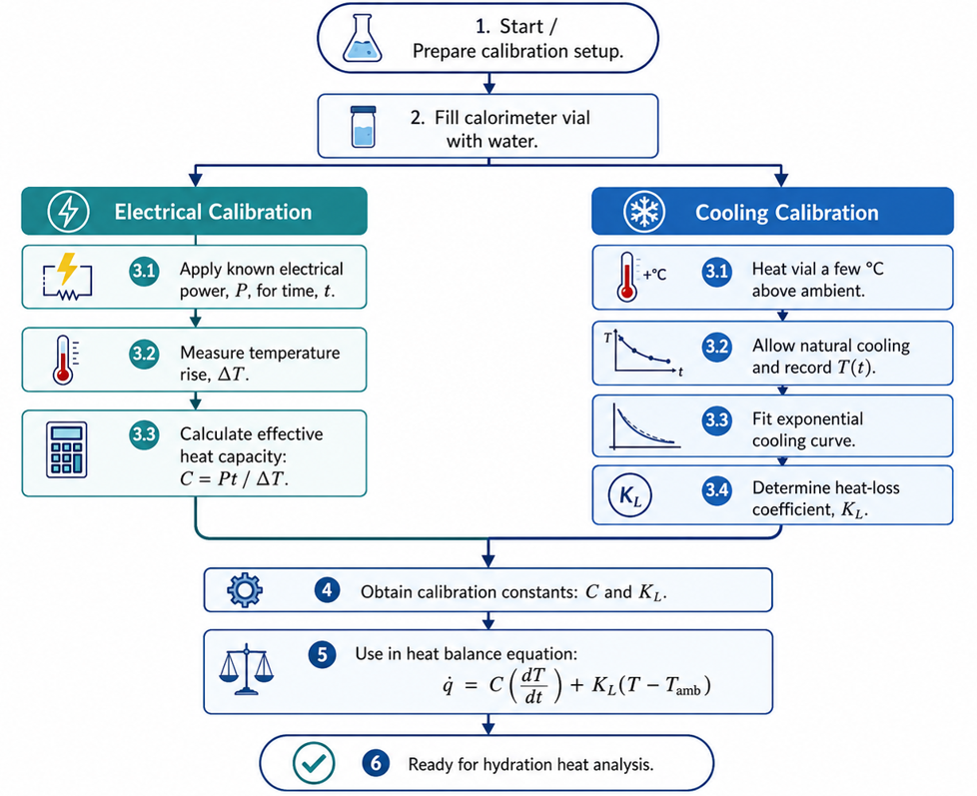
Calorimeter Calibration
2004153
17
Zisan Zia • 2004153
Dept. of Civil Engineering, BUET

Slide 18
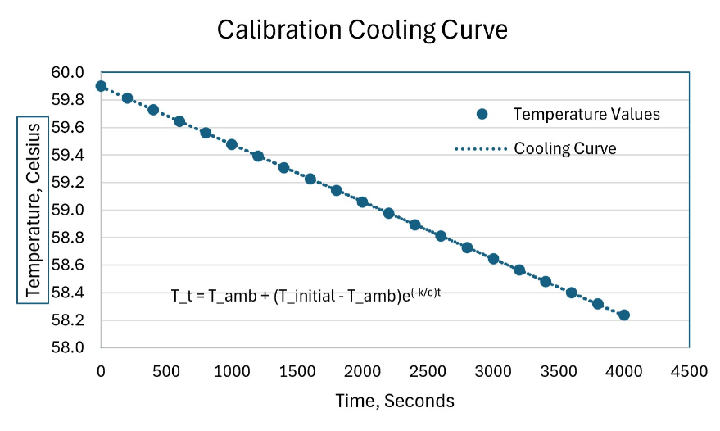
Calorimeter Calibration
2004153
18
Zisan Zia • 2004153
Dept. of Civil Engineering, BUET

Slide 19
Calorimeter Calibration
2004153
1
System capacity, C
2
Insulator capacity
3
Heat-loss coeff., Kᴸ
3076.9 J/K
1386.6 J/K
0.0356 W/K
How we calibrated
Cooling model
Electrical heating test → temperature rise → determine C
Cooling test → exponential decay → extract Kᴸ from T(t) curve
C and Kᴸ inserted into heat balance equation for all test runs
T(t) − Tₐₘᵦ = (T₀ − Tₐₘᵦ) · e^(−Kᴸt / C)
Uncertainty from calibration: ~±3%
19
Zisan Zia • 2004153
Dept. of Civil Engineering, BUET

Slide 20
Heat Calculation Algorithm
2004061
Processing logic from raw temperature data to heat outputs
1
Clean &
Standardise
2
Hydration
Degree
3
Heat
Balance
4
Specific
Heat Rate
5
Integrate
& Fit
t → 0, 5, 10,… min
r(t) = Qv(t)
/ Qv,max
q̇ = Ca·dT/dt
+ KL(Ts−Tamb)
qg(t) = q̇ / mc
Q(t) = ∫ qg(t)·dt
▶
▶
▶
▶
→ Ts(t), Tamb(t)
→ r(t) at each step
→ Total heat flow q̇
→ Specific rate qg(t)
→ Cumulative heat Q(t)
Goal: convert T(t) measurements into qᵍ(t), Q(t), peak heat rate, and Gaussian fitting Curves for thermal simulation
Abdur Nur Tushar • 2004061
20
Dept. of Civil Engineering, BUET

Slide 21
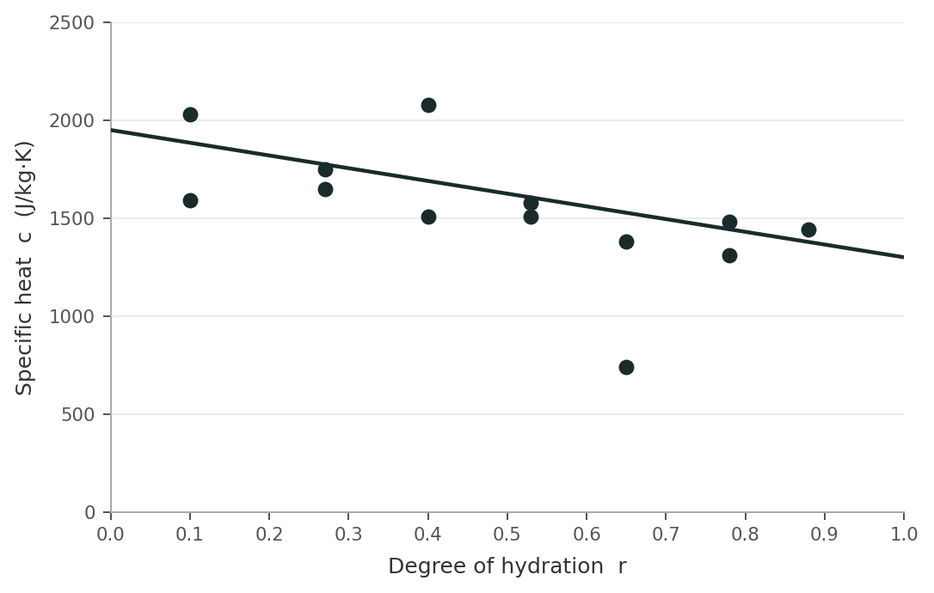
Variable Specific Heat of Hardening Cement Paste
2004061
Specific heat decreases linearly as hydration advances — De Schutter & Taerwe (1995)
Key Formula
Ca(r) = 1160.67 × (1.5 − 0.5·r)
J / kg · K
Adapted for CEM II A-M 42.5 R, w/c = 0.40
r = degree of hydration
(0 = fresh paste → 1 = fully hydrated)
Cₚ falls from ~1754 → ~1300 J/kg·K
as denser C-S-H gel replaces water
De Schutter and Taerwe (1995) established a relationship between the specific heat of cement paste and the degree of hydration
21
Abdur Nur Tushar • 2004061
Dept. of Civil Engineering, BUET

Slide 22
Key Outputs and What They Mean
2004061
Parameters used for comparison and thermal risk assessment
Q_{g}(t)
Specific Heat Generation Rate
The peak time and amplitude distinguish fast from slow cements.
Q(t)
Cumulative Heat Release
Higher Heat larger adiabatic ΔT and greater thermal cracking risk.
Peak time
Time to Maximum Heat Rate
Earlier peak means faster early reaction.
α(t)
Degree of Hydration
Mea (0→1). Used for VCCTL comparison and variable heat-capacity correction.
Risk rank
Cement Selection Output
Combines heat magnitude + timing → ranks cements for mass concrete use
22
Abdur Nur Tushar • 2004061
Dept. of Civil Engineering, BUET

Slide 23
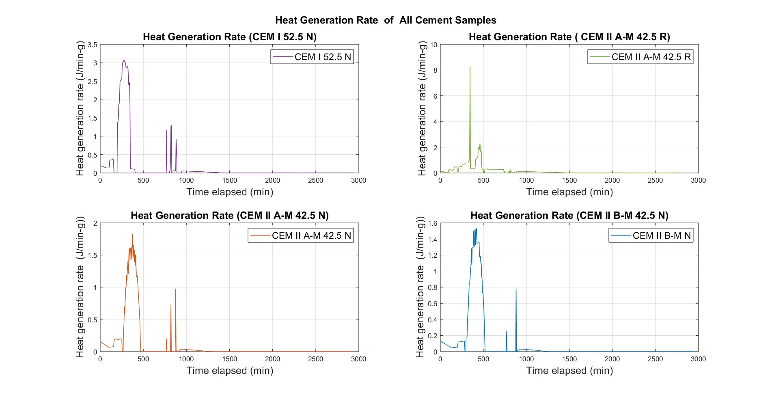
Result Detail: CEM I , CEM II A-M R, CEM II A-M N, CEM II B-M N
2004061
High clinker content produces the strongest and fastest hydration heat response.
Goal: convert T(t) data into qᵍ(t), Q(t), peak heat rate, and model-ready fitting curves for thermal simulation.
23
Abdur Nur Tushar • 2004061
Dept. of Civil Engineering, BUET

Slide 24
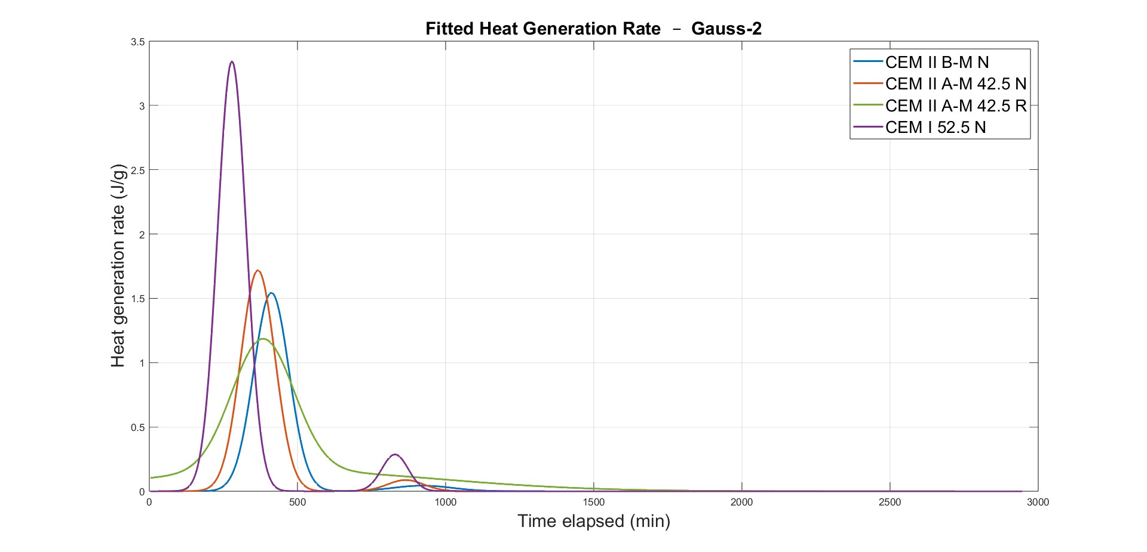
Result Detail: CEM I , CEM II A-M R, CEM II A-M N, CEM II B-M N
2004061
High clinker content produces the strongest and fastest hydration heat response.
Peak height
Peak time
Peak width
Peak width
Tail behavior
Tail behavior
Goal: convert T(t) data into qᵍ(t), Q(t), peak heat rate, and model-ready fitting curves for thermal simulation.
24
Abdur Nur Tushar • 2004061
Dept. of Civil Engineering, BUET

Slide 25
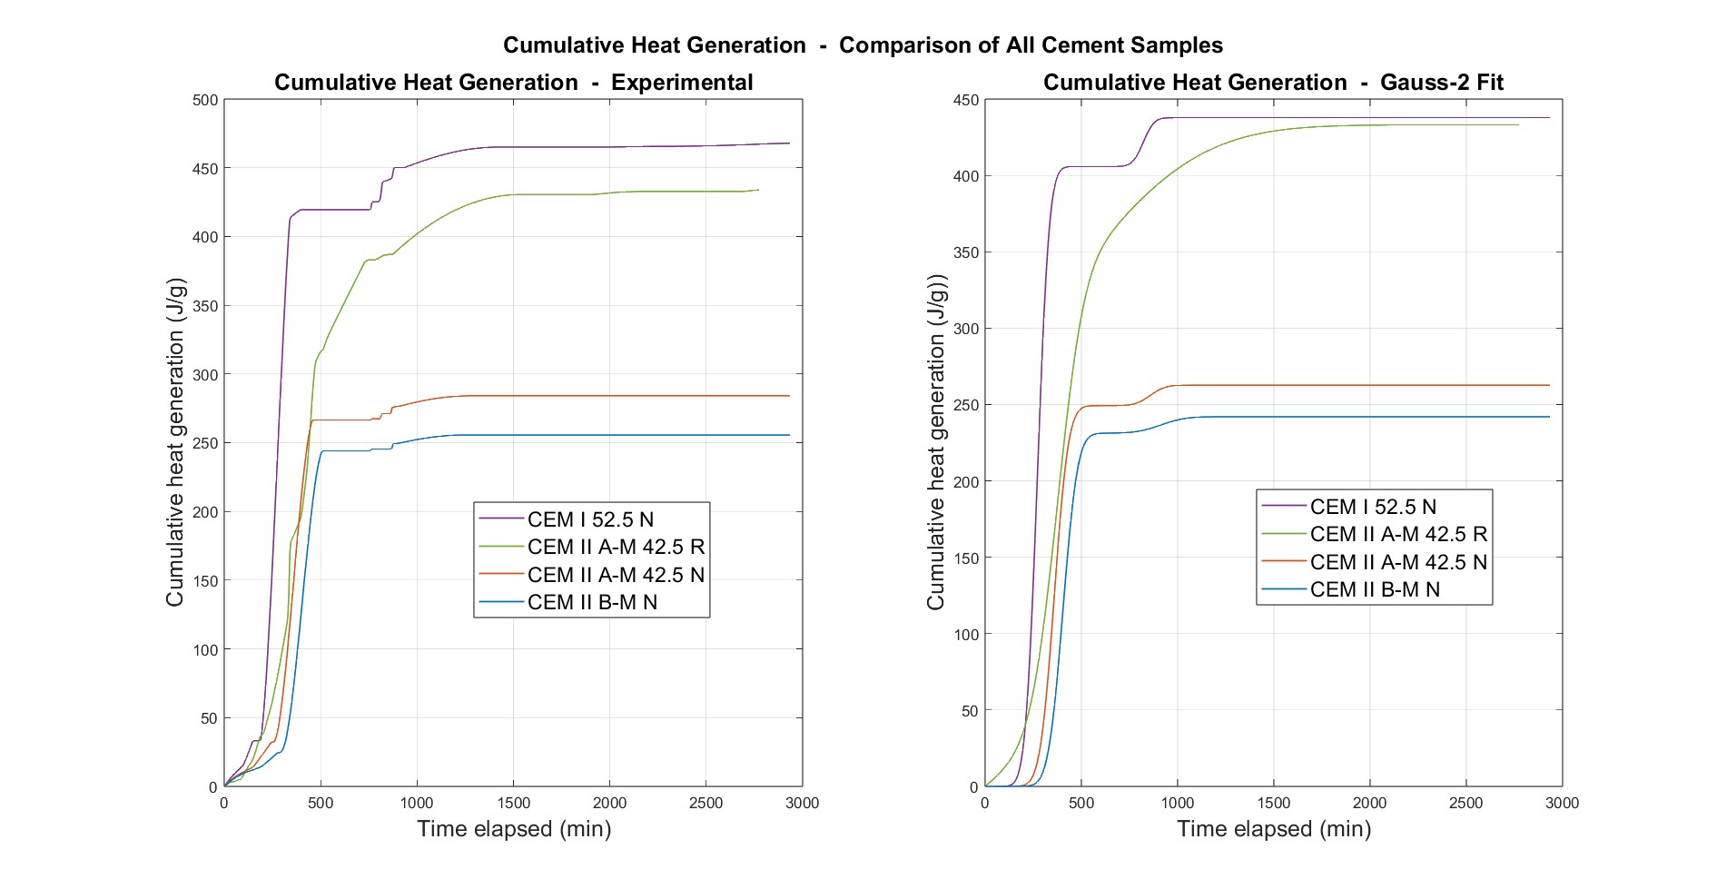
Result Detail: CEM I , CEM II A-M R, CEM II A-M N, CEM II B-M N
2004061
High clinker content produces the strongest and fastest hydration heat response.
Goal: convert T(t) data into qᵍ(t), Q(t), peak heat rate, and model-ready fitting curves for thermal simulation.
25
Abdur Nur Tushar • 2004061
Dept. of Civil Engineering, BUET

Slide 26
Result Detail: CEM I , CEM II A-M R, CEM II A-M N, CEM II B-M N
2004061
High clinker content produces the strongest and fastest hydration heat response.
Approximate final cumulative heat release
Goal: convert T(t) data into qᵍ(t), Q(t), peak heat rate, and model-ready fitting curves for thermal simulation.
26
Abdur Nur Tushar • 2004061
Dept. of Civil Engineering, BUET

Slide 27
Results: Cumulative Heat Release
2004061
Terminal Q at end of monitoring period — experimental vs. Gaussian model fit
CEM I 52.5 N: ~467 J/g — highest cumulative heat. Greatest thermal cracking risk (ΔT > 40°C adiabatic).
CEM II A-M 42.5 R: ~433 J/g — almost as high as Portland, driven by finer grinding and higher surface area.
CEM II A-M 42.5 N: ~284 J/g — intermediate; mineral additions dilute clinker and slow hydration.
CEM II B-M 42.5 N: ~255 J/g — lowest heat. Best choice for thermally sensitive mass concrete.
Cumulative Heat Release (J/g)
27
Abdur Nur Tushar • 2004061
Dept. of Civil Engineering, BUET

Slide 28
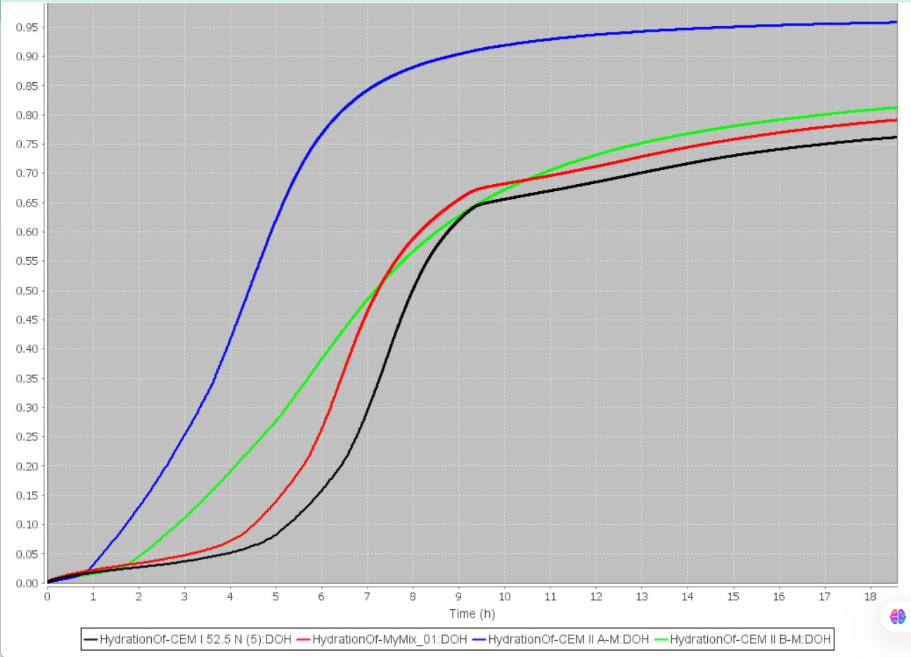
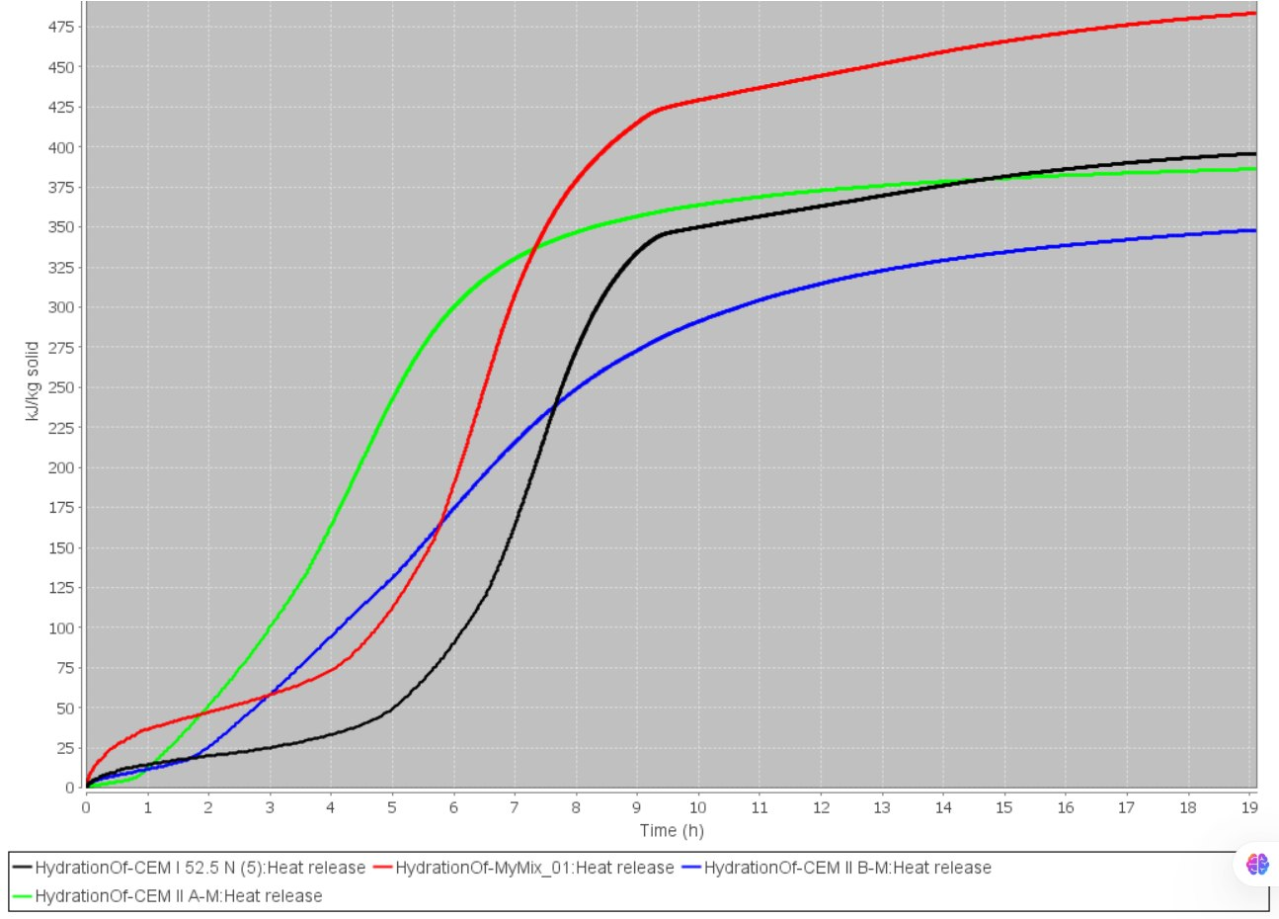
VCCTL Hydration Simulation
2004061
VCCTL-predicted degree of hydration at 19 h
DOH comparisons
28
Abdur Nur Tushar • 2004061
Dept. of Civil Engineering, BUET
Notes:
Show the DOH values. Explain that isothermal VCCTL may differ in absolute numbers, but trend validation is the key.

Slide 29
VCCTL heat release validation
2004061
CEM I
≈480 kJ/kg
A-M N
≈390 kJ/kg
B-M N
≈348 kJ/kg
A-M R
≈445 kJ/kg
VCCTL cumulative heat release at 19 h
29
Abdur Nur Tushar • 2004061
Dept. of Civil Engineering, BUET
Notes:
Use this slide to connect validation with conclusions. The simulated values support the experimental interpretation.

Slide 30
VCCTL Simulation and Validation
2004061
NIST VCCTL independently confirms the experimental heat rankings
VCCTL Degree of Hydration at 19 h (isothermal)
Cement | DOH at 19h
CEM I 52.5 N | ≈ 0.80
CEM II A-M 42.5 R | ≈ 0.800
CEM II A-M 42.5 N | ≈ 0.950
CEM II B-M 42.5 N | ≈ 0.825
VCCTL systematically over-predicts composite cement heat (isothermal vs semi-adiabatic). Relative ranking is fully confirmed. Residual scatter within ±3% calibration uncertainty.
Heat release at 19h Experimental (J/g) vs VCCTL (kJ/kg) same relative scale
30
Abdur Nur Tushar • 2004061
Dept. of Civil Engineering, BUET

Slide 31
Conclusions and Practical Implications
2004061
Thermal Cracking Risk Ranking
CEM I 52.5 N
CEM II A-M 42.5 R
CEM II A-M 42.5 N
CEM II B-M 42.5 N
~467 J/g
ΔT > 40°C
~433 J/g
ΔT 32–38°C
~284 J/g
ΔT 25–28°C
~255 J/g
ΔT 22–25°C
HIGHEST RISK
HIGH
MODERATE
LOWEST RISK
Key Findings
CEM II B-M 42.5 N is the safest choice for mass concrete in tropical Bangladesh (lowest ΔT).
Rapid-hardening CEM II A-M 42.5 R behaves closer to Portland cement than to normal composite — requires thermal management in large pours.
VCCTL confirms experimental rankings; over-prediction of blended cements is physically consistent with isothermal vs semi-adiabatic test differences.
31
Abdur Nur Tushar • 2004061
Dept. of Civil Engineering, BUET

Slide 32
Recommendations For Future Work
2004061
1
Extended Material Testing
2
Advanced Characterisation
Test more cement brands & batches; vary w/c (0.30, 0.45, 0.50); investigate elevated curing temperatures relevant to Bangladesh’s tropical climate.
Apply Rietveld XRD for precise phase quantification; combine with XRF elemental analysis; use SEM, TGA & FTIR to characterise hydration products.
3
Scale-Up to Structural Level
4
Thermal Modelling & FEM
Extend from paste to mortar & concrete; study aggregate thermal effects; assess influence of chemical admixtures (retarders, superplasticisers).
Embed Gaussian & polynomial heat models into finite-element solvers; apply Arrhenius activation-energy correction for field temperature prediction.
5
VCCTL Improvement
6
Field Validation & Guidelines
Supply quantitative phase data, measured PSD and Blaine fineness as inputs; compare isothermal, semi-adiabatic & adiabatic outputs systematically.
Monitor temperature in real mass-concrete placements; develop a practical cement-selection guide for temperature-sensitive construction in Bangladesh.
32
Abdur Nur Tushar • 2004061
Dept. of Civil Engineering, BUET

Slide 33
Heat of Hydration of Portland and Composite Cements Under Semi-Adiabatic Conditions
Thank You
Abdur Nur Tushar & Zisan Zia
Student No. 2004061 & 2004153
Supervised by
Dr. Raquib Ahsan
Professor, Dept. of Civil Engineering, BUET
Department of Civil Engineering • Bangladesh University of Engineering and Technology • June 2026
Abdur Nur Tushar • 2004061
Dept. of Civil Engineering, BUET
33
Abdur Nur Tushar • 2004061
Dept. of Civil Engineering, BUET

